Slide 1

SENTIMENT ANALYSIS OF CRYPTOCURRENCY TWEETS: PREDICTING BITCOIN MARKET SENTIMENT AND PRICE MOVEMENTS USING MACHINE LEARNING
Amarpreet Kaur
St. No: 501213603

Slide 2
SENTIMENT ANALYSIS OF CRYPTOCURRENCY TWEETS: PREDICTING BITCOIN MARKET SENTIMENT AND PRICE MOVEMENTS USING MACHINE LEARNING
Amarpreet Kaur
Student Id. 501213603
Toronto Metropolitan University, ON
Supervisor: Tamer Abdou
Date of Submission: Jul 24, 2023

Slide 3


INTRODUCTION
Sentiment analysis of cryptocurrency-related tweets, with a focus on Bitcoin, allows us to uncover market sentiment and public perception, providing valuable insights for making informed decisions and investments in the dynamic world of digital currencies.

Slide 4


DATA SOURCES
From Kaggle Tweets - 1,69,761 rows and 13 columns and
Historical data - 12,037 columns and 10 rows
From CryptoCompare API for live data- Bitcoin price data
To predict sentiment, price and change in price based one sentiments (tweets) and to predict price based on historical data.

Slide 5

EXECUTIVE SUMMARY PROBLEM STATEMENTS
How does sentiment analysis of tweets relating to Bitcoin correlate with the price dynamics of Bitcoin, specifically examining the influence of sentiment on Bitcoin's price change?
How do different machine learning algorithms, such as Naïve Bayes, Support Vector Machine, Decision Tree, Random Forest, Logistic Regression, and Gradient Boosting, perform in sentiment prediction for cryptocurriencies-related tweets on Twitter, and which algorithm(s) yield the highest prediction accuracy?
What is the comparative effectiveness of various machine learning regression models, including Multiple Linear Regression, Decision Tree Regressor, Random Forest Regressor, Support Vector Regressor, Gradient Boosting Regressor, and Neural Network Regressor, in predicting cryptocurriencies prices and changes in price (delta) based on sentiments from tweets?
How does the utilization of Time Series Models improve the accuracy of cryptocurriencies price prediction for Bitcoin (BTC), Ethereum (ETH), Ripple (XRP), Litecoin (LTC), and USD Coin (USDC) based on their historical data? What are the potential limitations and challenges associated with using Time Series Models for cryptocurriencies price prediction?

Slide 6


EXECUTIVE SUMMARY SOLUTION
Sentiment Calculation – VADER and Text Blob
Sentiment prediction – Five Classification Models
Price and Price change (Delta) Predictions based on Sentiment (Sentiment as independent attribute)- Six Regression Models
Prediction of five cryptocurrencies based on Historical Data – Four Time Series Models

Slide 7

EXECUTIVE SUMMARY TOOLS USED
The chosen programming language for this project is Python, which offers a wide range of libraries for data analysis and model building.

Slide 8
EXECUTIVE SUMMARY CONCLUSION
The analysis of the tweet scores, including the lag, magnitude, and slope, in relation to the changes in Bitcoin prices provides valuable insights into the dynamics of Twitter sentiment and its impact on the cryptocurrency market.
The Support Vector Machines (SVM) model consistently performed well across various metrics and demonstrated strong performance with high accuracy based on cross-validation results.
Random Forest and Gradient Boosting regressors exhibit better performance in prediction price as well as price change (delta).
Some currencies may benefit from using SMA, whereas ARIMA, LSTM, and Prophet each possess unique strengths and weaknesses.

Slide 9


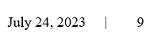
APPROACH
Data Collection
Preprocessing
Sentiment Analysis
Prediction
Results Interpretation
Tweets Dataset
Crypto Dataset
Tweets Cleaning
Sentiment Analysis with VADER AND Text Blob
Data Preparation & EDA
Sentiment Score Vs Price
Sentiment Score Vs Price Change
Models, evaluation, and Cross Validation
Sentiment
Price
Price Change
Conclusion
Recommendations
4
5
1
3
2

Slide 10
EXPLORATORY DATA ANALYSIS – (EDA) TWEETS Data Dictionary
No | Columns | Descriptions | Data Type
1 | user_name | The name of the user, as they’ve defined it. | object (string)
2 | user_location | The user-defined location for this account’s profile. | object (string)
3 | user_description | The user-defined UTF-8 string describing their account. | object (string)
4 | user_created | Time and date, when the account was created. | object (string)
5 | user_followers | The number of followers an account currently has. | float64 (number)
6 | user_friends | The number of friends an account currently has. | float64 (number)
7 | user_favourites | The number of favorites an account currently has | float64 (number)
8 | user_verified | When true, indicates that the user has a verified account | bool (boolean)
9 | date | UTC time and date when the Tweet was created | datetime64[ns]
10 | text | The actual UTF-8 text of the Tweet | object (string)
11 | hashtags | All the other hashtags posted in the tweet along with #Bitcoin & #btc | object (string)
12 | source | Utility used to post the Tweet; Tweets from the Twitter website have a source value - web | object (string)
13 | is_retweet | Indicates whether this Tweet has been Retweeted by the authenticating user. | float64 (number)

Slide 11
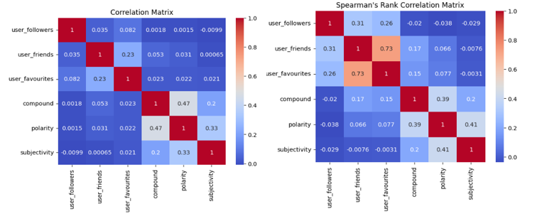
CORRELATION AND STATISTICAL SUMMARY
User friends and user favourites are highly correlated.

Slide 12
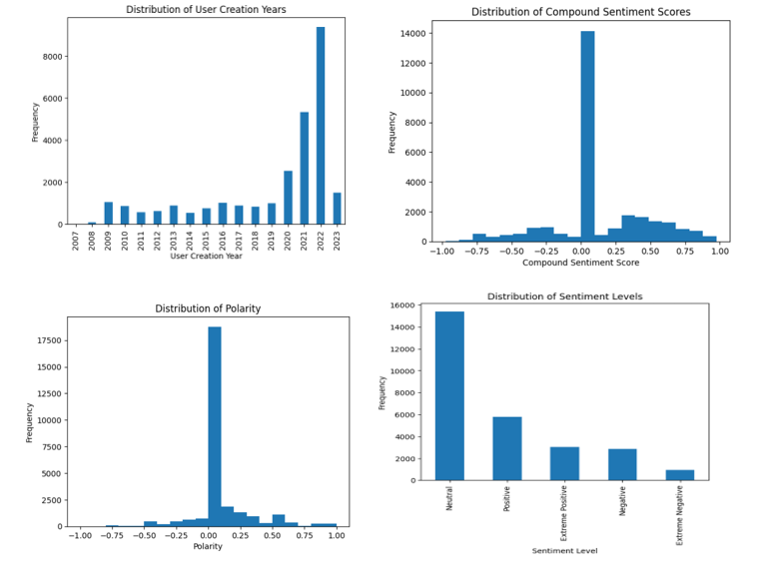
UNIVARIATE ANALYSIS

Slide 13
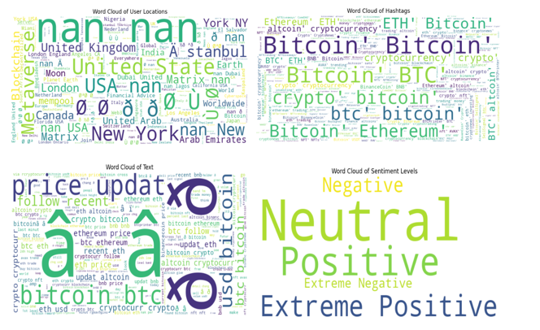
UNIVARIATE ANALYSIS WORD CLOUD

Slide 14
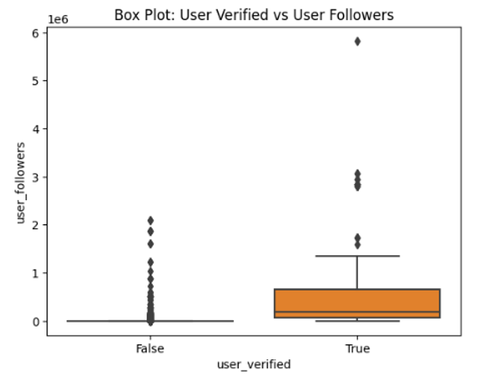
BIVARIATE ANALYSIS

Slide 15
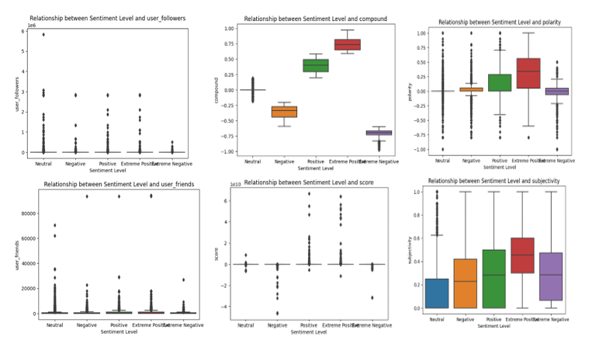
BIVARIATE ANALYSIS

Slide 16
CRYPTOCURRENCIES DATA DESCRIPTION
Column Name | Description | Variable Type | Data Type
SNo | Serial number | Numerical (Nominal) | int64
Name | Name of the crypto currency | Categorical (Nominal) | object
Symbol | The crypto currency symbol | Categorical (Nominal) | object
Date | The date of the recorded data point | Date (Dataframe) | object
High | The highest price reached by the crypto currency on the given date | Numerical (Continuous) | float64
Low | The lowest price reached by the crypto currency on the given date | Numerical (Continuous) | float64
Open | The opening price of the crypto currency on the given date | Numerical (Continuous) | float64
Close | The closing price of the crypto currency on the given date | Numerical (Continuous) | float64
Volume | The trading volume of the crypto currency on the given date | Numerical (Continuous) | float64
Marketcap | The market capitalization of the crypto currency on the given date | Numerical (Continuous) | float64

Slide 17
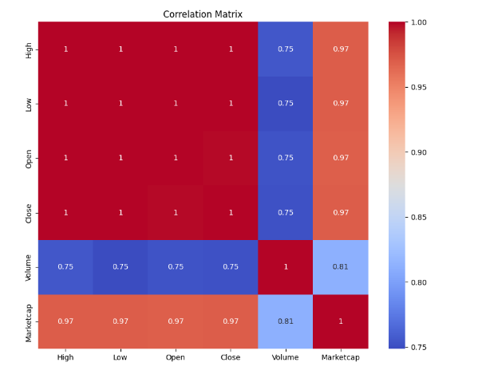
CORRELATION AND STATISTICAL SUMMARY

Slide 18
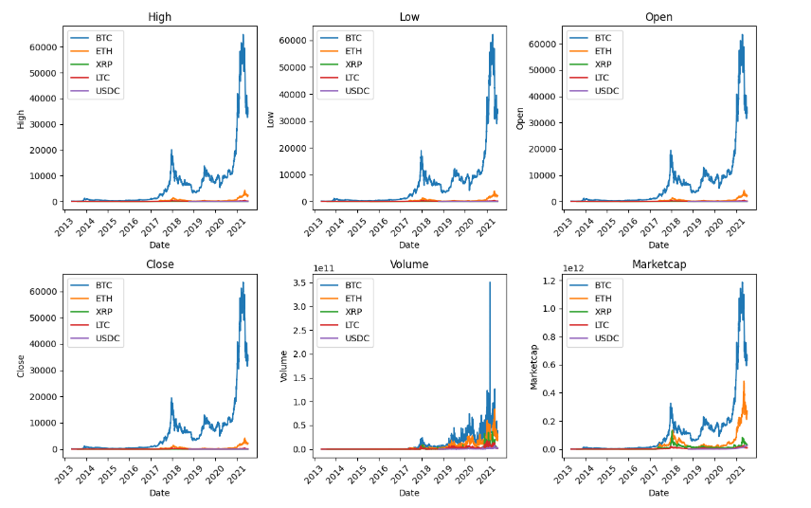
UNIVARIATE ANALYSIS Time-series plot for each coin with each numeric column

Slide 19
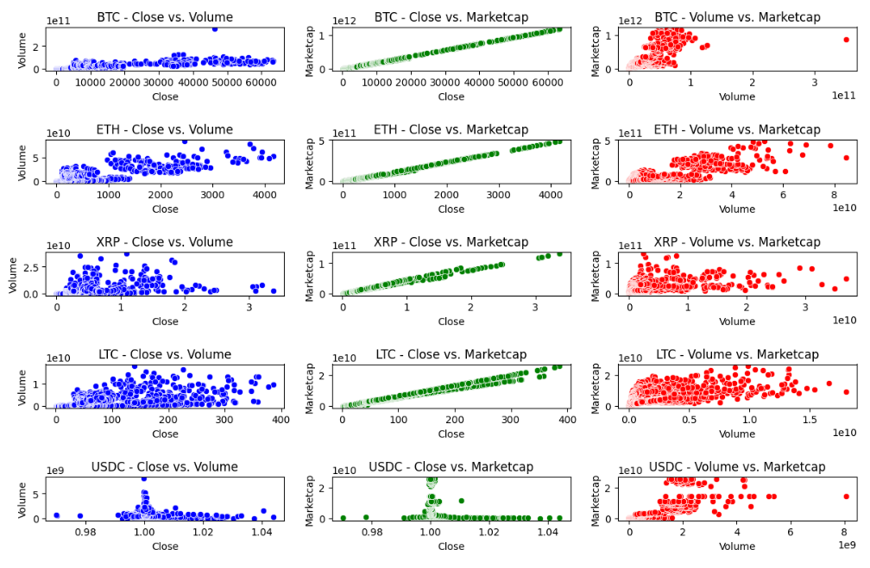
BIVARIATE ANALYSIS

Slide 20
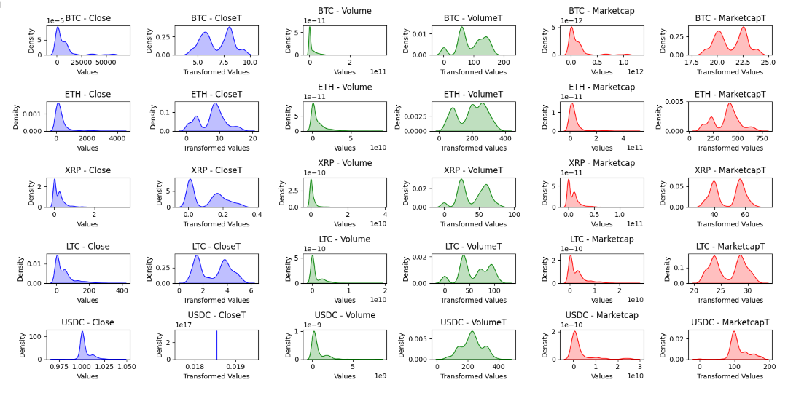
SKEWNESS Plotting the original and transformed sidewise to compare.

Slide 21
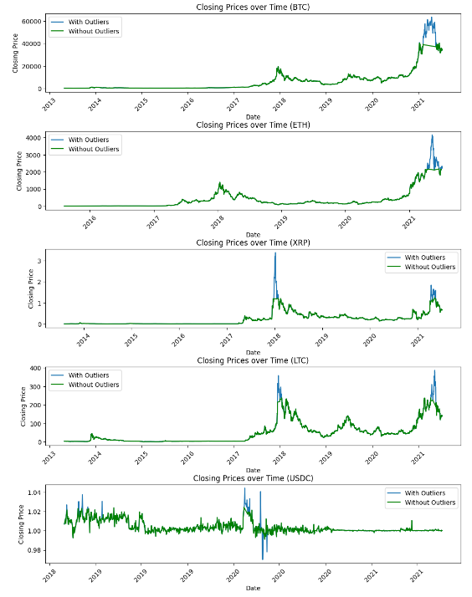
OUTLIERS ANALYSIS Plotting with and without outliers

Slide 22


MERGING DATASETS
Upon gathering the data, I conducted alignment on both the Bitcoin tweets and cryptocurrency data by using predefined one-minute time windows. This ensured that the data points from both sources were synchronized to the same time intervals. The aligned data was then stored for subsequent processing.
Tweets dataset
Cryptocurrency Dataset
Merged Dataset

Slide 23
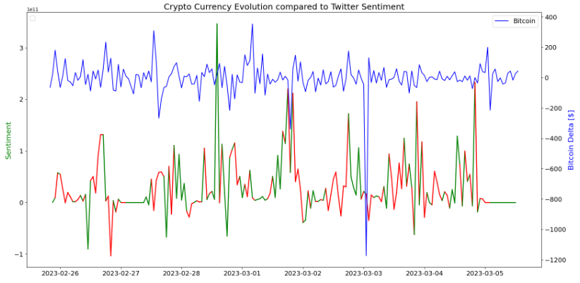
SENTIMENT ANALYSIS SENTIMENT VS PRICE CHANGE (DELTA)- SLOPE AND MAGNITUDE

Slide 24
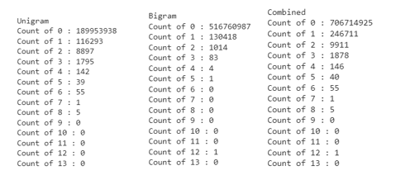
CLASSIFICATION MODELS FOR SENTIMENT PREDICTION FEATURE SELECTION
Term Frequency Matrix – Unigram, Bigram and Combined

Slide 25
CLASSIFICATION MODELS FOR SENTIMENT ANALYSIS
Classification Model | Accuracy | Precision | Recall | F1-Score | Predicted sentiment
Naive Bayes | 79% | 80% | 79% | 79% | Neutral
Support Vector Machines (SVM) | 86% | 86% | 86% | 86% | Neutral
Random Forest | 86% | 86% | 86% | 85% | Neutral
Logistic Regression | 86% | 86% | 86% | 85% | Neutral
Gradient Boosting | 85% | 85% | 85% | 84% | Neutral
RESULTS AND CONCLUSIONS BASED ON CLASSIFICATION MODELS FOR SENTIMENT PREDICTION
The differences in performance among the models were relatively small.
The Support Vector Machines (SVM) model consistently performed well across various metrics, achieving the highest accuracy, recall, and competitive precision and F1-score.
The Random Forest and Logistic Regression models also demonstrated competitive performance.

Slide 26
CROSS VALIDATION
Classification Model | Cross-Validation Scores | Accuracy
Naive Bayes | 79% | 79%
Support Vector Machines (SVM) | 86% | 86%
Random Forest | 86% | 86%
Logistic Regression | 84% | 85%
Gradient Boosting | 84% | 84%
SVM and Random Forest demonstrate strong performance with high accuracy based on cross-validation results.

Slide 27
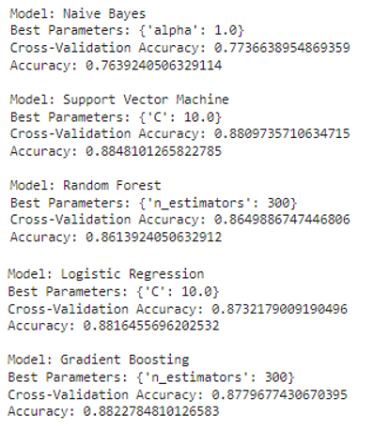
HYPERTUNNING PARAMETERS

Slide 28
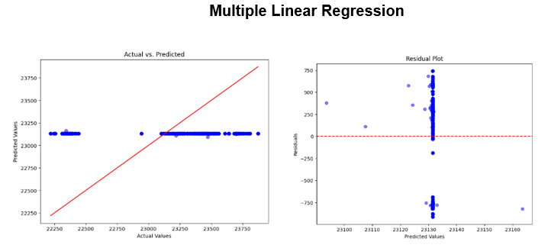
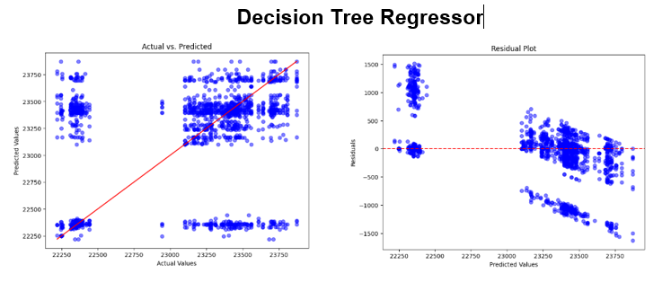
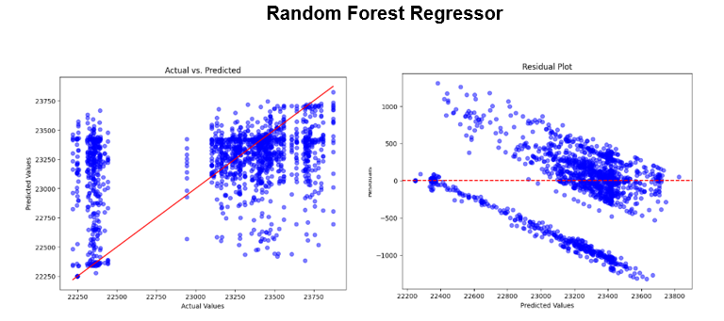
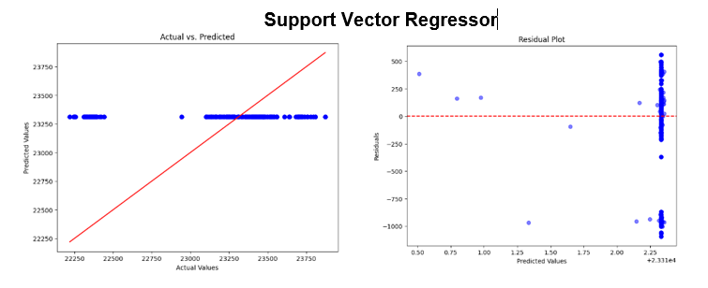
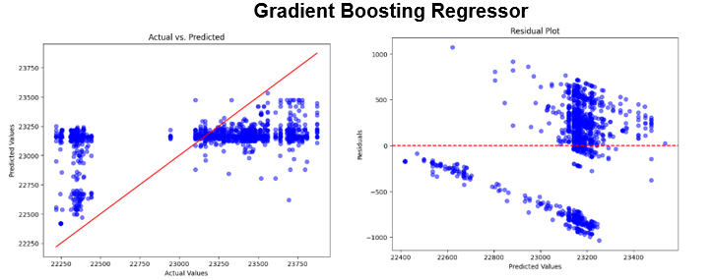
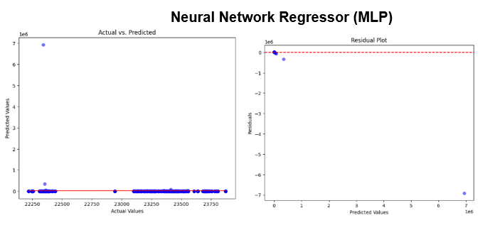
REGRESSION MODELS FOR PRICE PREDICTION

Slide 29
COMPARISON TABLES
Regression Model | Mean Squared Error | R-squared | Mean Absolute Error | Root Mean Squared Error | Predicted Close Price
Multiple Linear Regression | 263642.15 | -0.0002768 | 434.52 | 513.46 | 23131.47
Decision Tree Regressor | 330171.61 | -0.2526942 | 372.79 | 574.60 | 23457.06
Random Forest Regressor | 229402.74 | 0.1296298 | 332.16 | 478.96 | 22660.31
Support Vector Regressor | 297238.96 | -0.1277454 | 399.94 | 545.19 | 23312.32
Gradient Boosting Regressor | 218755.55 | 0.1700260 | 378.03 | 467.71 | 23144.45
Neural Network Regressor | 312875279304.78 | -1187069.7590 | 51811.64 | 559352.55 | 2.23
Note as per reference [19]: The best possible score is 1 which is obtained when the predicted values are the same as the actual values. R2 score of baseline model is 0 and during the worse cases, R2 score can even be negative.
The Random Forest and Gradient Boosting regressors demonstrate better predictive capabilities compared to Multiple Linear Regression and Decision Tree Regressor, with lower mean squared errors and positive R-squared values.

Slide 30
CROSS VALIDATION
Regression Model | Mean MSE | Std MSE
Linear Regression | 369821.09 | 306106.77
Decision Tree Regressor | 465009.63 | 335780.03
Random Forest Regressor | 358518.17 | 372697.44
Support Vector Regressor | 347812.17 | 401289.32
Gradient Boosting Regressor | 348887.68 | 310402.67
Neural Network Regressor | 3.12E+1 | 4.70E+13
The Support Vector Regressor stands out as the best performer among the presented models, showing the lowest Mean MSE and displaying promise for accurate predictions.

Slide 31
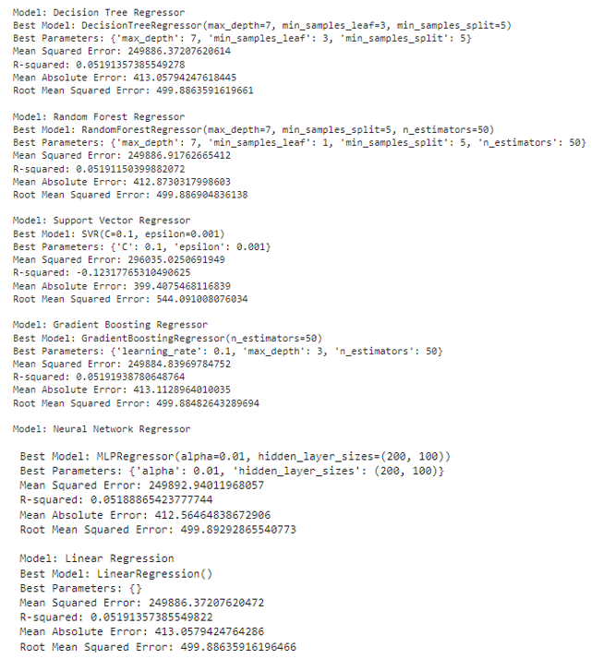
HYPERTUNNING PARAMETERS

Slide 32
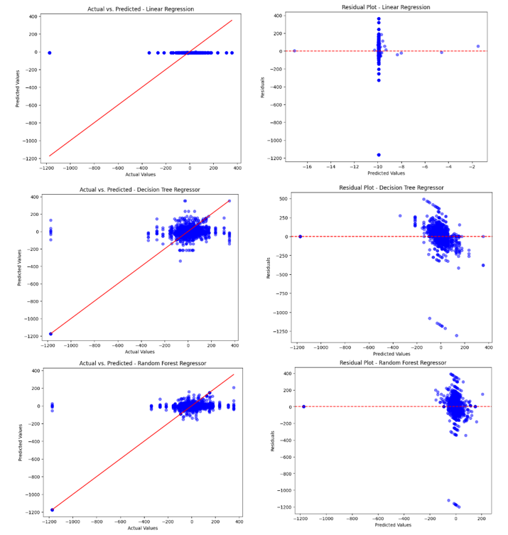
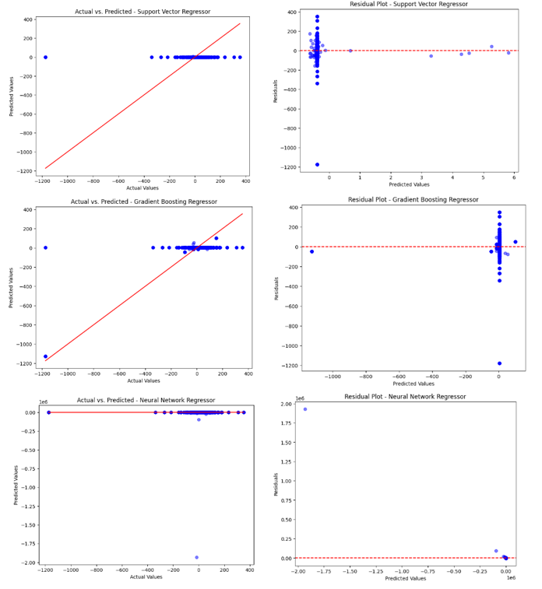
REGRESSION MODELS FOR PRICE CHANGE (DELTA) PREDICTIONS

Slide 33
COMPARISON TABLE
Regression Model | Mean Squared Error | R-squared | Mean Absolute Error | Root Mean Squared Error | Predicted Change Prediction (Delta)
Linear Regression | 2.72E+04 | 0.000017 | 77.29 | 164.91 | -9.94
Decision Tree Regressor | 1.61E+04 | 0.408726 | 71.75 | 126.80 | 16
Random Forest Regressor | 1.42E+04 | 0.478842 | 64.99 | 119.05 | 8.42
Support Vector Regressor | 2.73E+04 | -0.003254 | 76.81 | 165.17 | -0.39
Gradient Boosting Regressor | 1.40E+04 | 0.484404 | 64.94 | 118.41 | 3.66
Neural Network Regressor | 2.37E+09 | -87042.17517 | 1415.69 | 48653.96 | -0.25
The Random Forest Regressor and Gradient Boosting Regressor demonstrated relatively better performance in predicting the change in price (delta) compared to other models.

Slide 34
CROSS VALIDATION
Regression Model | Mean MSE | Std MSE
Multiple Linear Regression | 26602.32 | 34442.20
Decision Tree Regressor | 29497.64 | 34444.12
Random Forest Regressor | 26945.52 | 34605.31
Support Vector Regressor | 26258.12 | 34451.38
Gradient Boosting Regressor | 26563.17 | 34572.29
Neural Network Regressor | 1.82E+14 | 3.44E+14
The Multiple Linear Regression, Support Vector Regressor, and Gradient Boosting Regressor models showed relatively lower mean squared error (MSE) values, indicating better performance in predicting Bitcoin price changes. However, the Neural Network Regressor had significantly higher MSE values and performed poorly in this task. Further optimization and experimentation may be needed to improve model performance.

Slide 35
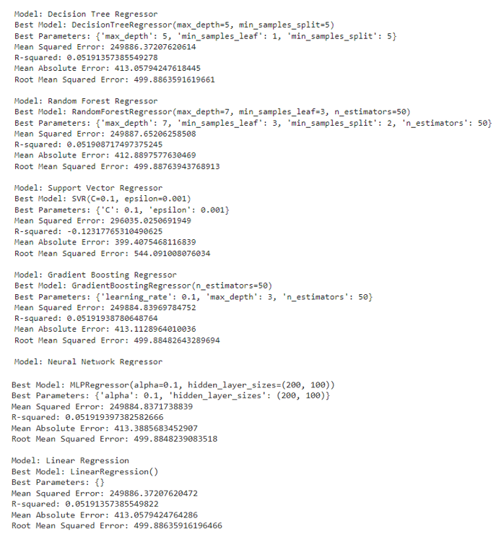
HYPERTUNNING PARAMETERS
After hyperparameter tuning, slight improvements were observed in model performance. However, all models showed limited capability to explain the variance in Bitcoin price changes, as indicated by the low R-squared values. Further refinement and incorporating historical price data may enhance predictive power for future price prediction.

Slide 36
TIME SERIES MODELS FOR FIVE CRYTOCURRENCIES PRICE PREDICTION
Simple Moving Average (SMA)
Autoregressive Integrated Moving Average (ARIMA)
Prophet
Deep Learning Techniques - LSTM model

Slide 37
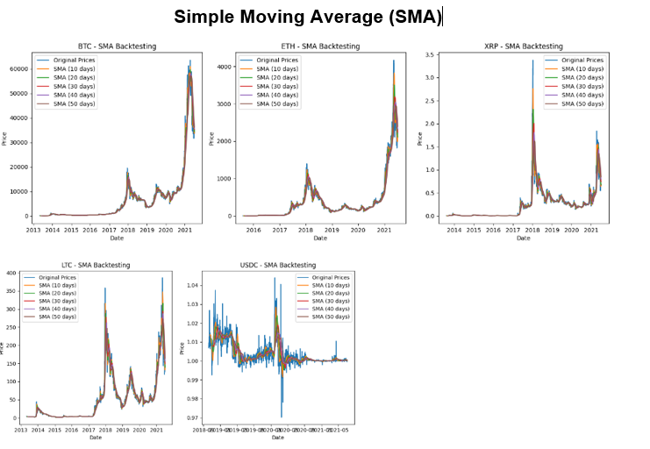
Simple Moving Average (SMA)
Coin | MSE (30 day) | MAE (30 day) | RMSE (30 day) | MAPE (30 day) | MSE (60 day) | MAE (60 day) | RMSE (60 day) | MAPE (60 day)
BTC | 3.53E+ | 739.6 | 1880.01 | 9.79 | 8.71E+ | 1216.11 | 2951.51 | 14.8
ETH | 20026.5 | 60.8 | 141.515 | 15.46 | 40000 | 89.75 | 200 | 22.34
XRP | 0.022 | 0.048 | 0.15 | 14.88 | 0.037 | 0.068 | 0.19 | 21.
LTC | 359.3 | 7.9 | 18.95 | 12.95 | 650.76 | 11.62 | 25.51 | 19.3
USDC | 2.49E- | 0.002 | 0.0049 | 0.26 | 2.64E- | 0.0028 | 0.0051 | 0.2
Bitcoin and Ethereum show higher errors, XRP, Litecoin, and USD Coin exhibit relatively better predictive performance with lower errors and higher accuracy.

Slide 38
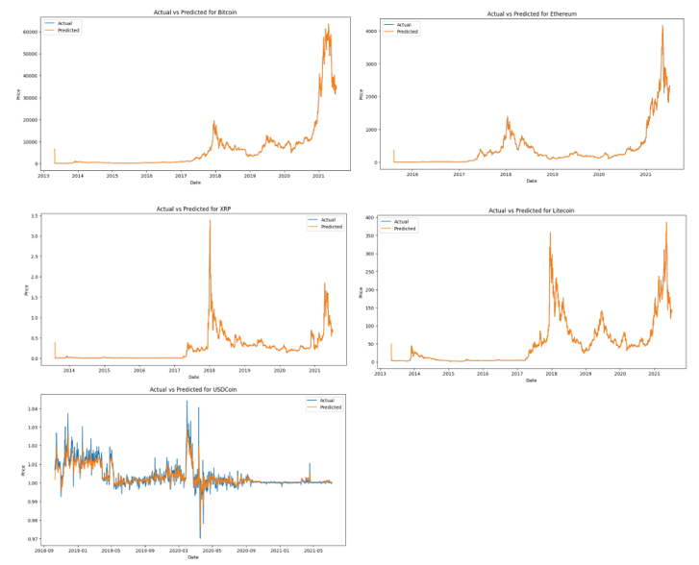
Autoregressive Integrated Moving Average (ARIMA)
Coin | Mean Absolute Error | Mean Squared Error | Root Mean Squared Error | Mean Absolute Percentage Error
Bitcoin | 209.93 | 357706.50 | 598.08 | 4.47
Ethereum | 17.21 | 2332.79 | 48.29 | 32.38
XRP | 0.014 | 0.0018 | 0.043 | 24.18
Litecoin | 2.33458 | 37.48 | 6.12 | 6.05
USDCoin | 0.0024 | 1.76E-05 | 0.0041 | 0.23
The ARIMA model performs differently for various cryptocurrencies, with Ethereum and USDCoin showing relatively accurate predictions.

Slide 39
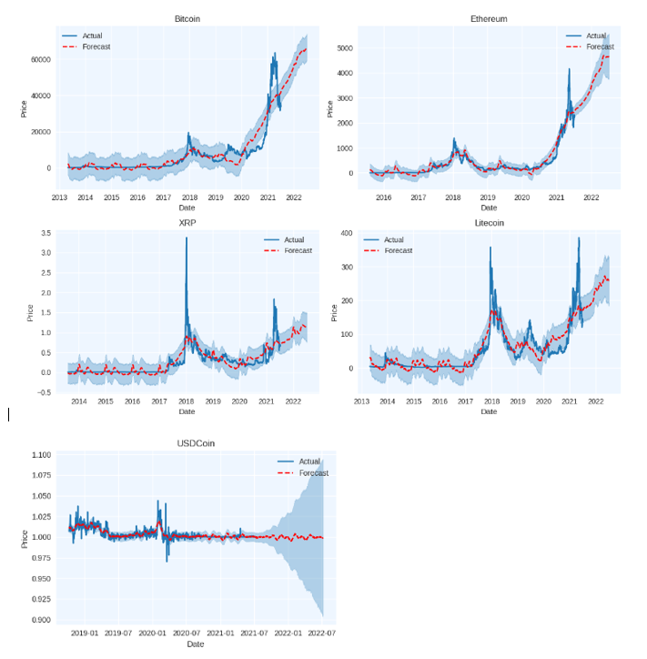
Prophet
Coin | Mean Squared Error | Root Mean Squared Error | Mean Absolute Error | R2 Score
Bitcoin | 2.28E+07 | 4770.50 | 2895.87 | 0.82
Ethereum | 3.17E+04 | 177.91 | 108.10 | 0.91
XRP | 3.87E-02 | 0.19 | 0.11 | 0.66
Litecoin | 8.69E+02 | 29.47 | 19.794 | 0.78
USDCoin | 1.75E-05 | 0.0041 | 0.0026 | 0.62
The Prophet model shows potential in predicting cryptocurrency prices, with Ethereum exhibiting the highest accuracy.

Slide 40
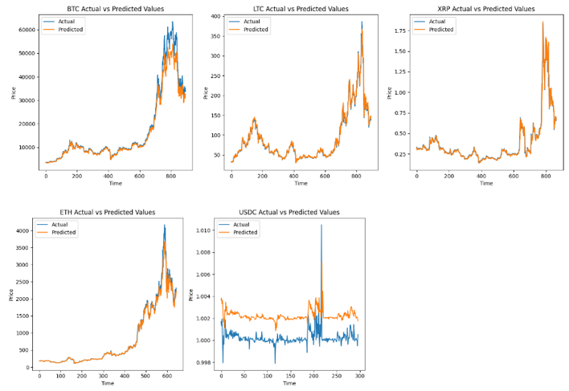
Deep Learning Techniques LSTM model without any dropout layers
Coin | MSE | RMSE | MAE | MAPE | Corr | R2
BTC | 7.75E+06 | 2784.63 | 1422.4 | 5.64 | 0.99 | 0.96
LTC | 6.54E+01 | 8.08 | 4.28 | 4.27 | 0.99 | 0.98
XRP | 2.10E-03 | 0.045 | 0.019 | 4.11 | 0.98 | 0.97
ETH | 1.19E+04 | 109.02 | 46.03 | 4.01 | 0.99 | 0.98
USDC | 4.60E-06 | 0.0021 | 0.002 | 0.20 | 0.30 | -5.80
LSTM models perform well for most cryptocurrencies, showing strong positive linear relationships and reasonable accuracy. However, the model for USDCoin falls short, exhibiting weaker performance and lower accuracy compared to other cryptocurrencies.

Slide 41
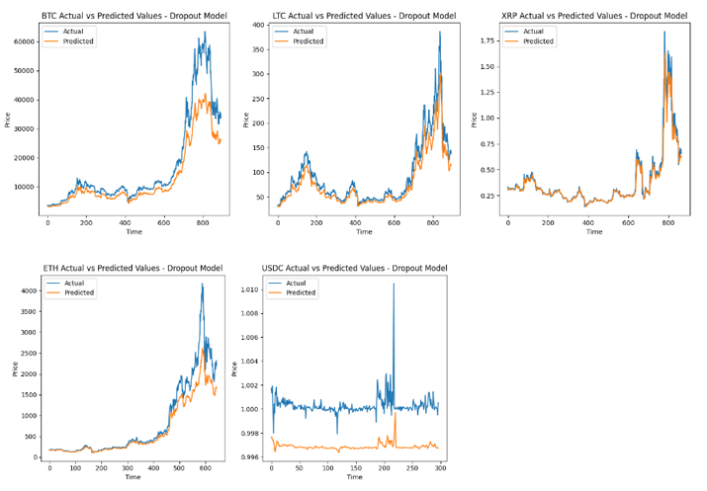
Deep Learning Techniques LSTM model with dropout layers
Coin | MSE | RMSE | MAE | MAPE | Corr | R2
BTC | 44407580 | 6663.9 | 4190.13 | 20.44 | 0.99 | 0.82
LTC | 451.03 | 21.23 | 15.17 | 14.65 | 0.99 | 0.88
XRP | 0.0036 | 0.0600 | 0.025 | 4.57 | 0.98 | 0.95
ETH | 107471.5 | 327.82 | 169.38 | 13.17 | 0.99 | 0.86
USDC | 1.23E-05 | 0.0035 | 0.0034 | 0.341 | 0.22 | -17.25
The LSTM model demonstrated promising accuracy for most cryptocurrencies, warranting further investigation, except for USDC, which performed poorly.

Slide 42

SELF REFLECTION
I gained valuable insights into the significance of sentiment analysis in
the cryptocurrency market and its potential impact on price movements.
Utilizing various machine learning algorithms for sentiment prediction and regression models for price forecasts, I gained valuable insights into their strengths and limitations.
I plan to continue exploring time series forecasting and applying my knowledge to real-world applications to contribute to the development of more accurate and efficient results.
Maximize timely deliverables for real-time schemas.​
The insights gained and the challenges encountered will serve as a
foundation for refining future projects.

Slide 43
LIMITATIONS
Challenges with sentiment analysis calculation
Limited availability of labeled data and Data bias
Rapidly evolving sentiment and Contextual understanding
Overreliance on textual data
Current libraries do not consider sarcasm
Sentiment can also be expressed through other modalities like images, videos, or audio
Presence of spam accounts, false accounts, and bots
Market manipulation, external events, or speculative trading behavior, can contribute to this discrepancy

Slide 44

FUTURE WORK
Collect tweets from high-profile accounts with market influence.
Increase data volume and expand trade date range for better model accuracy.
Consider other factors beyond investor and decision maker sentiments for broader research in the cryptocurrency market.
Explore removing false Twitter accounts to improve sentiment analysis.
Explore alternative machine learning techniques for sentiment score computation. (as current libraries do not take into account sarcasm)
Develop a robust big data platform for real-time analysis and prediction.

Slide 45
REFRENCES
Al Amrani, Y., Lazaar, M., & El Kadiri, K. E. (2022). Sentiment Analysis and Cryptocurrency Price Forecasting. International Journal of Advanced Computer Science and Applications, 13(10), 889-898. https://thesai.org/Downloads/Volume13No10/Paper_105_Cryptocurrency_Price_Prediction_using_Forecasting_and_Sentiment_Analysis.pdf
E. Edgari, J. Thiojaya and N. N. Qomariyah, "The Impact of Twitter Sentiment Analysis on Bitcoin Price during COVID-19 with XGBoost," 2022 5th International Conference on Computing and Informatics (ICCI), New Cairo, Cairo, Egypt, 2022, pp. 337-342, doi: 10.1109/ICCI54321.2022.9756123. https://ieeexplore-ieee-org.ezproxy.lib.torontomu.ca/stamp/stamp.jsp?tp=&arnumber=9756123
A. Ibrahim, "Forecasting the Early Market Movement in Bitcoin Using Twitter's Sentiment Analysis: An Ensemble-based Prediction Model," 2021 IEEE International IOT, Electronics and Mechatronics Conference (IEMTRONICS), Toronto, ON, Canada, 2021, pp. 1-5, doi: 10.1109/IEMTRONICS52119.2021.9422647. https://ieeexplore-ieee-org.ezproxy.lib.torontomu.ca/document/9422647
A. M. Balfagih and V. Keselj, "Evaluating Sentiment C1assifiers for Bitcoin Tweets in Price Prediction Task," 2019 IEEE International Conference on Big Data (Big Data), Los Angeles, CA, USA, 2019, pp. 5499-5506, doi: 10.1109/BigData47090.2019.9006140. https://ieeexplore-ieee-org.ezproxy.lib.torontomu.ca/document/9006140
Jacques Fleischer, Gregor von Laszewski, Carlos Theran, Yohn Jairo Parra Bautista “ Time Series Analysis of Blockchain-Based Cryptocurrency Price Changes “, 2022 https://paperswithcode.com/paper/time-series-analysis-of-blockchain-based#code
R. N, S. R. R, V. S. R and K. P. D, "Crypto-Currency Price Prediction using Machine Learning," 2022 6th International Conference on Trends in Electronics and Informatics (ICOEI), Tirunelveli, India, 2022, pp. 1455-1458, doi: 10.1109/ICOEI53556.2022.9776665. https://ieeexplore-ieee-org.ezproxy.lib.torontomu.ca/document/9776665
C. Saravanakumar, S. K. Lakshmi, M. Prakash, M. Vijayakumar and C. Arun, "An Efficient Ensemble Model for Forecasting Time Series Analysis of Crypto Currency Data Using Machine Learning," 2021 International Conference on Innovative Computing, Intelligent Communication and Smart Electrical Systems (ICSES), Chennai, India, 2021, pp. 1-5, doi: 10.1109/ICSES52305.2021.9633939. https://ieeexplore-ieee-org.ezproxy.lib.torontomu.ca/document/9633939
R. Nikita, S. J. Subhashini, Y. B. S, V. K. Vavle and D. A, "A Review on Digital Coin Investing Predictor," 2022 International Conference for Advancement in Technology (ICONAT), Goa, India, 2022, pp. 1-6, doi: 10.1109/ICONAT53423.2022.9726092. https://ieeexplore-ieee-org.ezproxy.lib.torontomu.ca/document/9726092
Pan, Linxi. (2023). Cryptocurrency Price Prediction Based on ARIMA, Random Forest and LSTM Algorithm. BCP Business & Management. 38. 3396-3404. 10.54691/bcpbm.v38i.4313. https://www.researchgate.net/publication/369430933_Cryptocurrency_Price_Prediction_Based_on_ARIMA_Random_Forest_and_LSTM_Algorithm
Yulin Liu, Luyao Zhang “Cryptocurrency Valuation: An Explainable AI Approach”, 2022 https://paperswithcode.com/paper/cryptocurrency-valuation-an-explainable-ai
Zhengyao Jiang, Jinjun Liang “Cryptocurrency Portfolio Management with Deep Reinforcement Learning”, 2016 https://paperswithcode.com/paper/cryptocurrency-portfolio-management-with-deep
Quentin Le Baron (2018) “How to make profits in cryptocurrency trading with machine learning” https://medium.com/smileinnovation/how-to-make-profits-in-cryptocurrency-trading-with-machine-learning-edb7ea33cee4
Raghav Agrawal (2023) “ Complete Guide to Ethereum Blockchain with Python” https://www.analyticsvidhya.com/blog/2023/01/complete-guide-to-web3-0-ethereum-blockchain-using-python/

Slide 46

Thank You

